Slide 1

FACE DETECTION SYSTEM
BY- ABHIJEET KUMAR
SANJNA KATYAL

Slide 2
FACE RECOGNITION
Face recognition is a method of identifying or verifying the identity of an individual using their face.
Facial recognition is becoming very popular with advancement in technologies along with voice and touch(fingerprint) recognition.
Government, mobile phone companies social media and many others use this surveillance/secuity system.
We have used Local Binary Pattern Histogram (LBPH )Classifier for recognition, with OpenCV and emguCV libraries.

Slide 3
OPENCV /EMGUCV
OpenCV (Open Source Computer Vision) is a popular computer vision library started by Intel in 1999.
EmguCV is a wrapper for OpenCv library for making its libraries available on .NET platform and C#.
The currently available algorithms are:
Eigenfaces
Fisherfaces
Local Binary Patterns Histograms (LBPH)

Slide 4
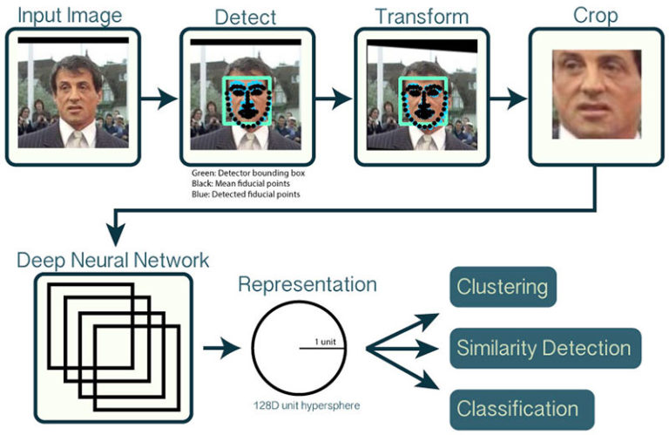
HOW OPENCV WORKS

Slide 5
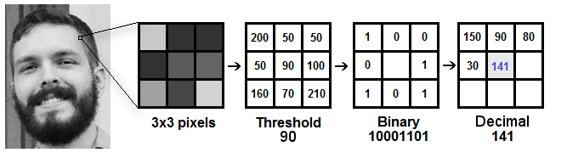
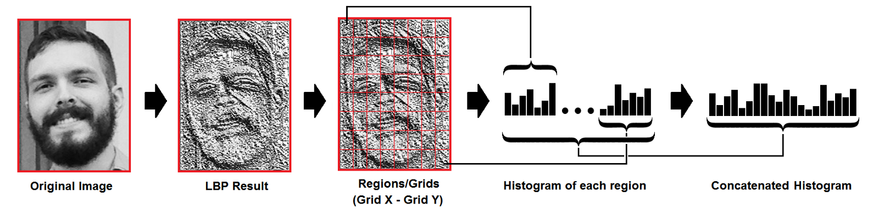
HOW LBPH WORKS!!

Slide 6
SCOPE
provide an automated and affordable solutions to small scale institutes while allowing them to reduce cost on security in long term as well making the surveillance effective
provide better performance over other security systems.
Real-time detection and recognition of people in a camera setup.
A face detector integrated with a people tracker for higher accuracy and faster detections is proposed.

Slide 7
LIMITATION
Poor Image Quality Limits Facial Recognition's Effectiveness.
Small Image Sizes Make Facial Recognition More Difficult.
Different Face Angles Can Throw Off Facial Recognition's Reliability.
Data Processing and Storage Can Limit Facial Recognition Tech.
Dependency on trained dataset (via light intensity, picture quality, variations in dataset , etc.)

Slide 8
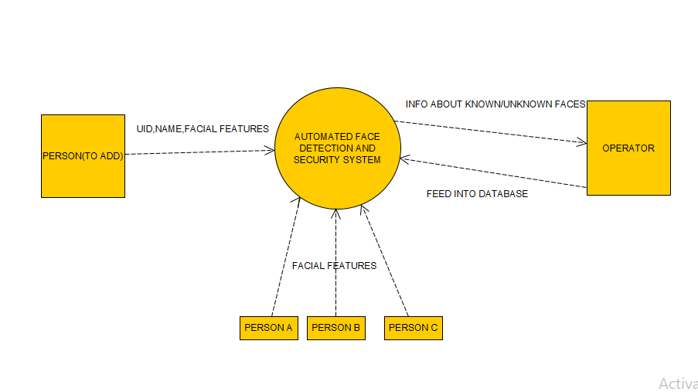
DFD

Slide 9
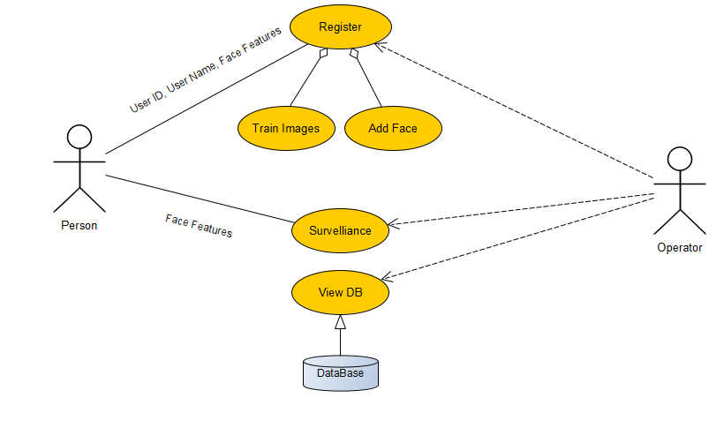
UML DIAGRAM

Slide 10
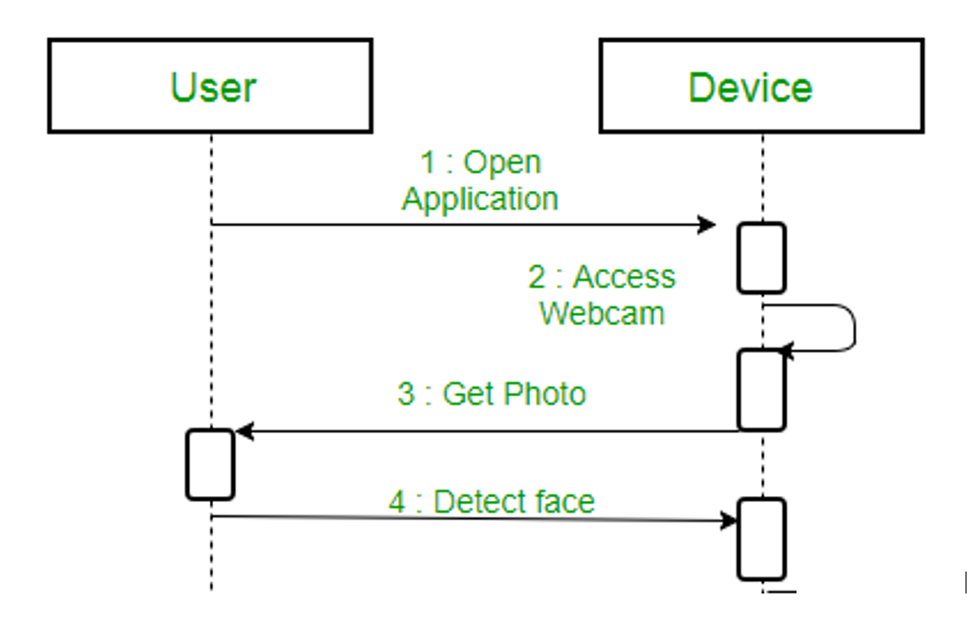
SEQUENCE DIAGRAM

Slide 11
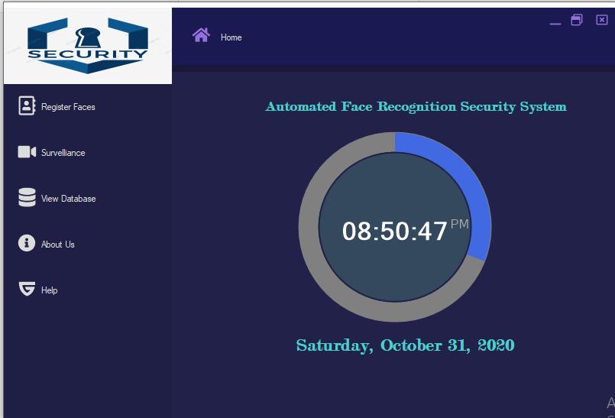
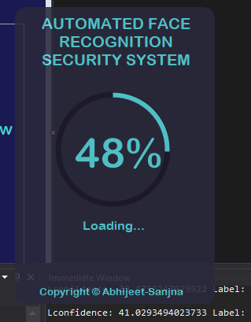
PROJECT SCREENSHOTS
SPLASH SCREEN _ LOADING..
HOME SCREEN

Slide 12
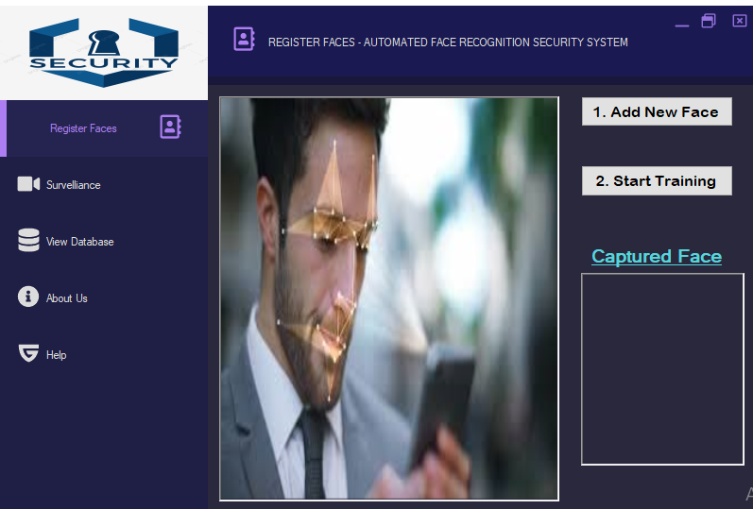
REGISTER FACES

Slide 13
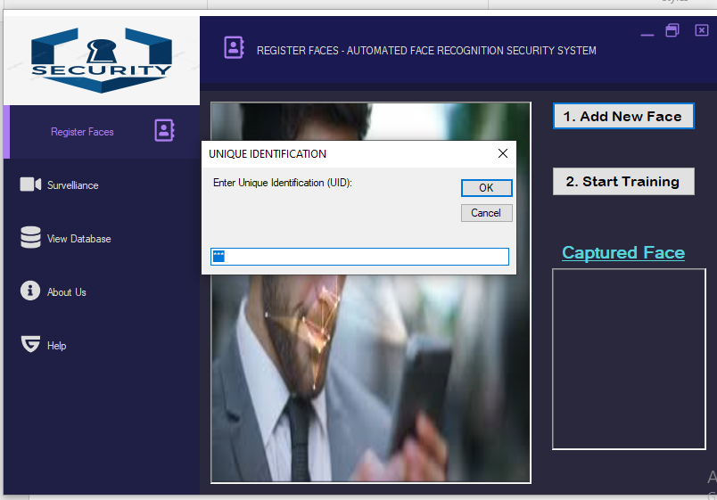

Slide 14
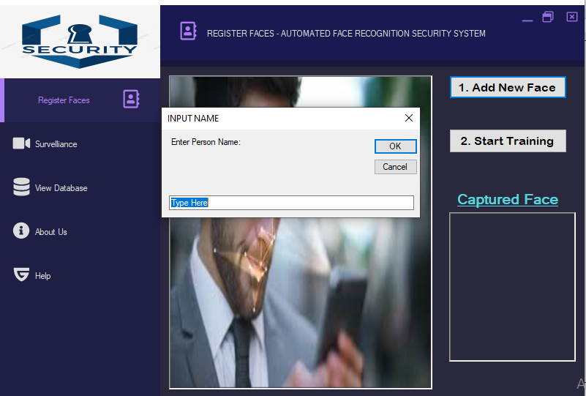

Slide 15
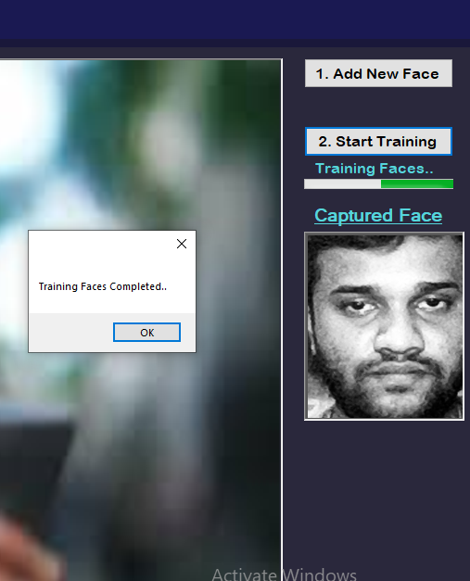
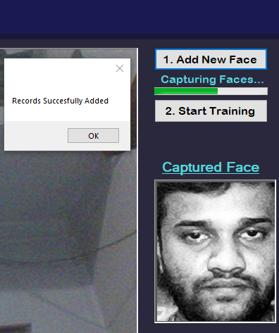

Slide 16
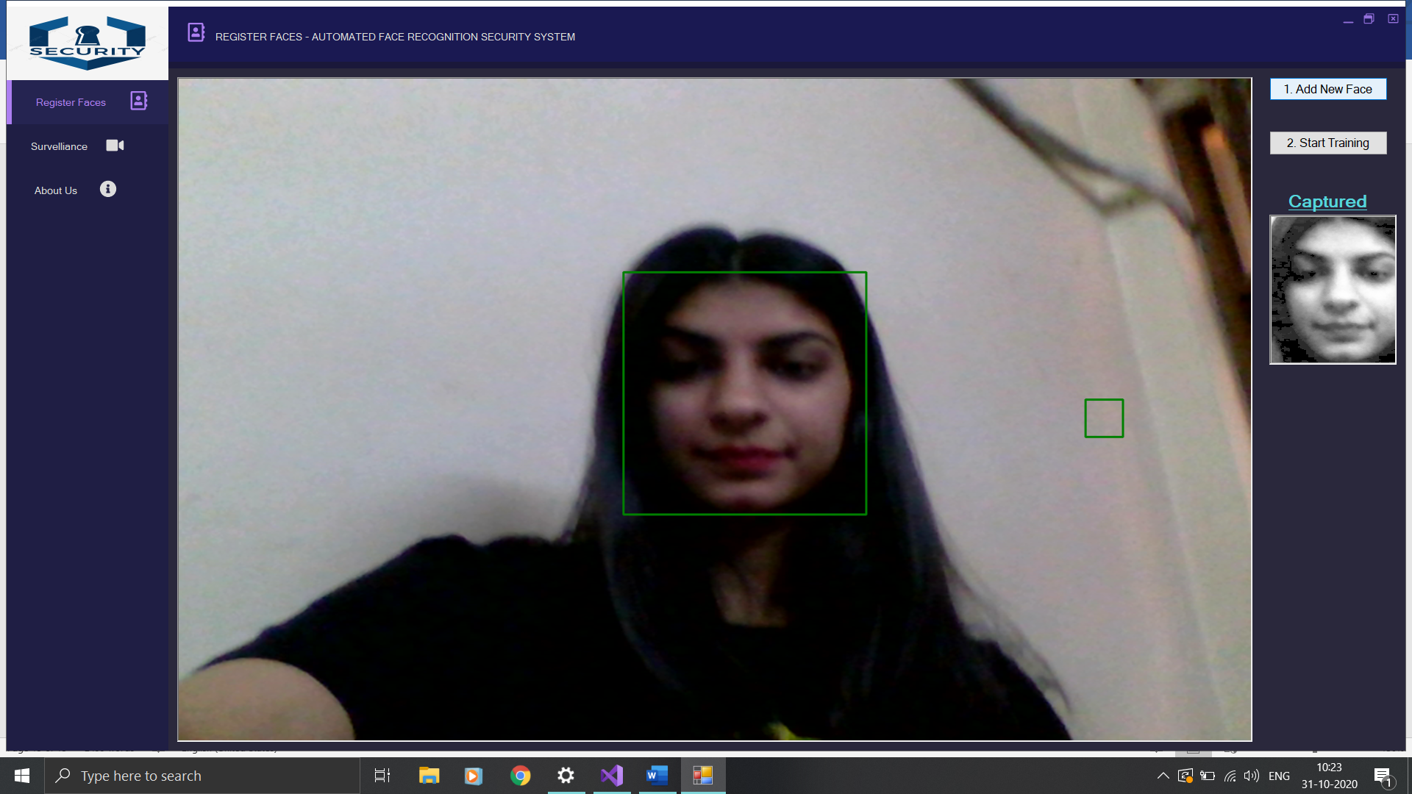

Slide 17
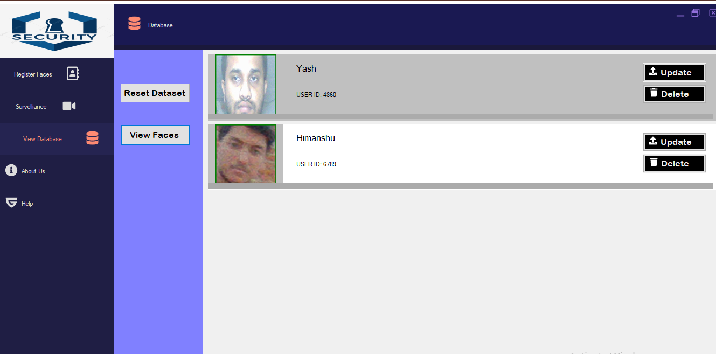

Slide 18
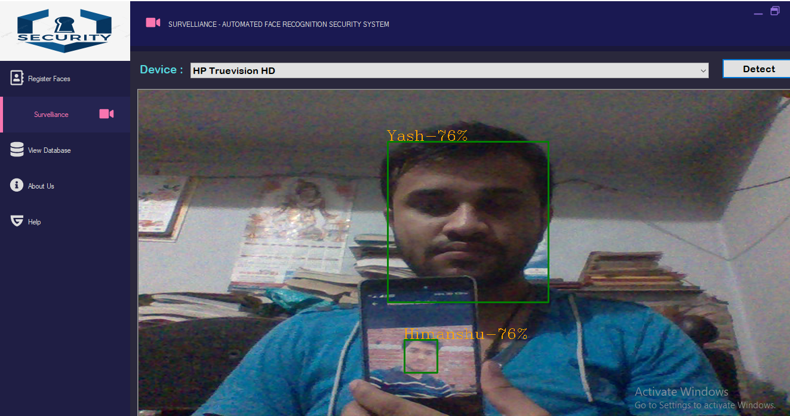

Slide 19
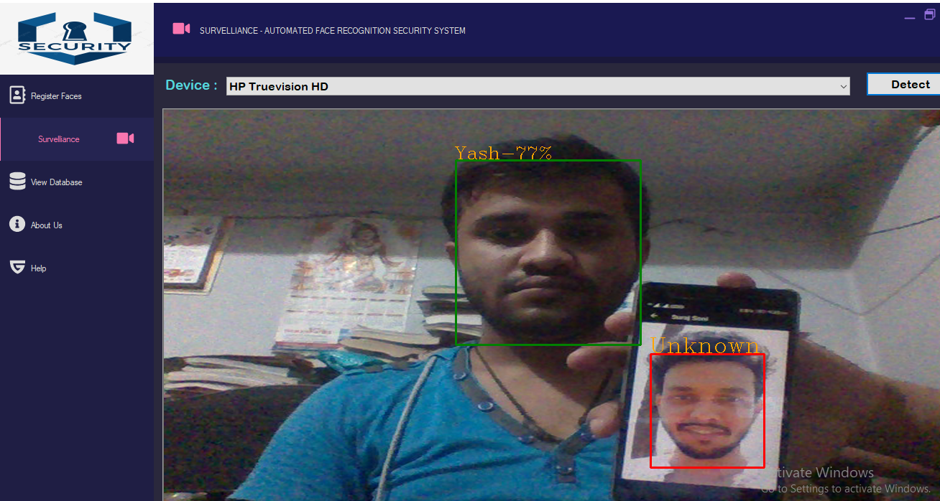

Slide 20
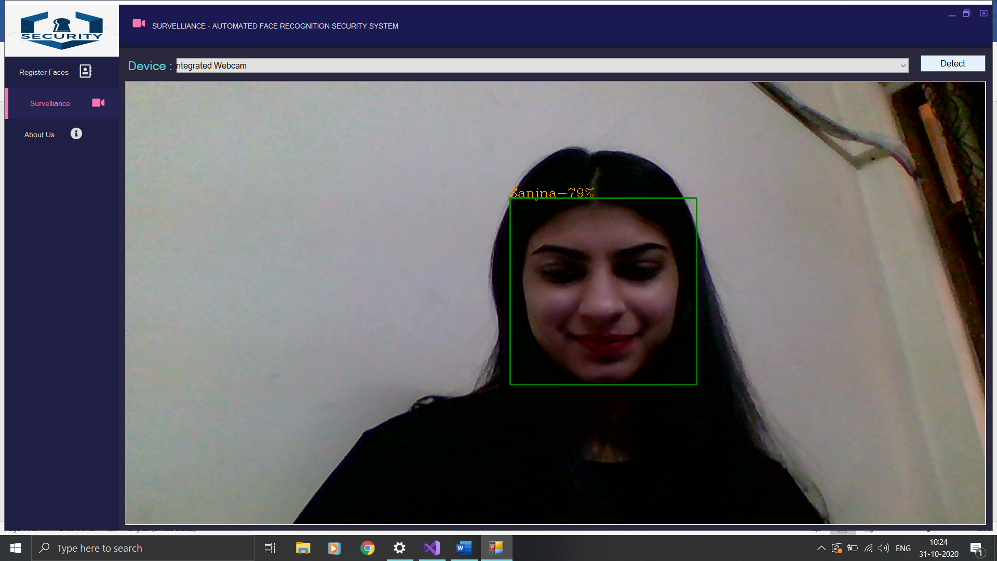

Slide 21
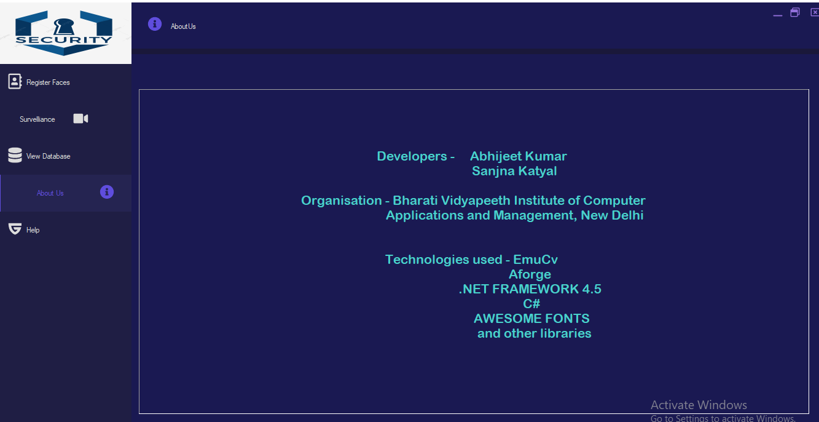

Slide 22
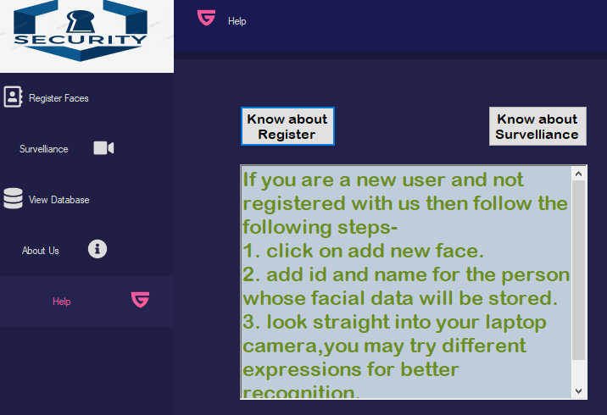
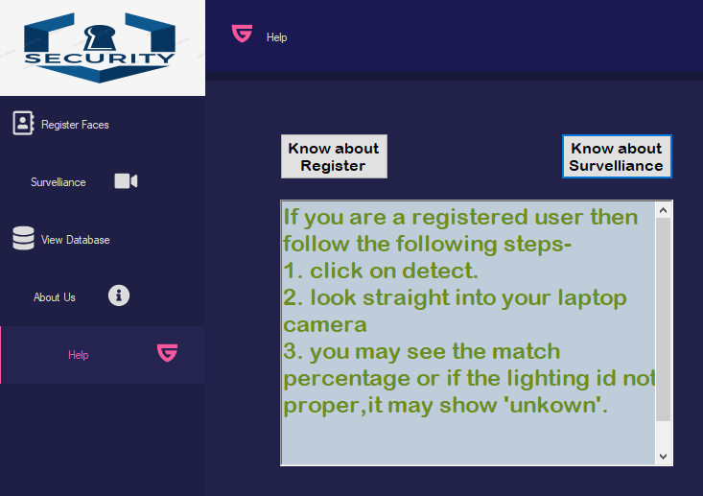

Slide 23
FUTURE SCOPE
We can further implement a licensed/serial key feature to avoid unauthorized use.
We can further extend our project to limit our options as per specific users with given rights.
We can maintain a database for registered users and extend its application for login/attendance system.
A further functionality can be created to show categorically persons identified as known and unknown from a live video feed in a given session.

Slide 24
THANKYOU

